Slide 1
From Zero to Hero: Backing Up Alfresco
Toni de la Fuente

Slide 2
$ whoami
Toni de la Fuente / @ToniBlyx / blyx.com
Atlanta (GA, US) based, Granada (ESP) raised
Lead Security Operations and Cloud Security Architect
Former Principal Solutions Engineer / Senior Solutions Engineer (USA, Spain and Portugal)
~8 years as Alfrescan + 3 years as partner
Prowler, Alfresco BART, Alfresco Security Best Practices Guide, Alfresco Backup and Disaster Recovery White Paper, AWS Quick Start for ACS, Nagios plugin, and more.

Slide 3
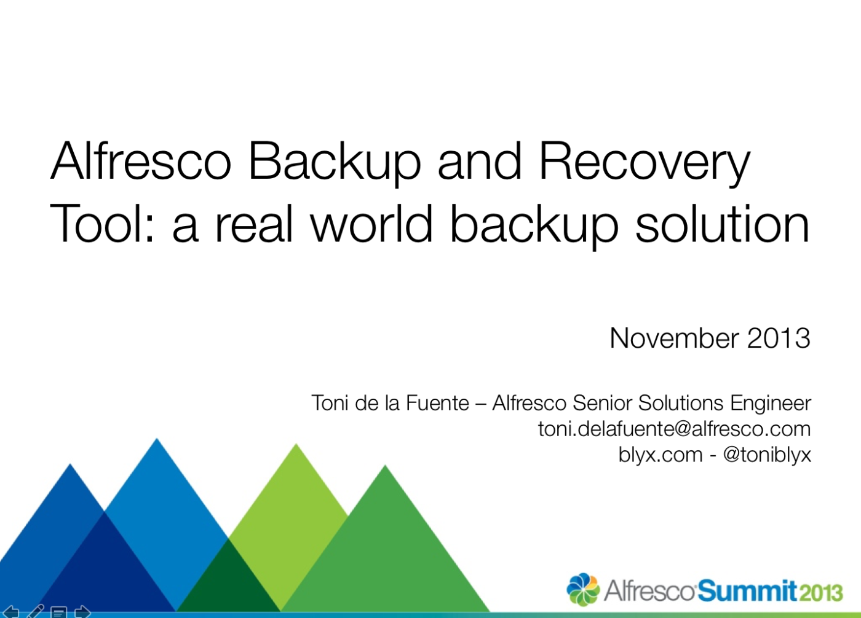
A bit of history on this
2013: Alfresco Backup and Disaster Recovery White Paper / Alfresco BART
Notes:
Alfresco BART
Lucene and Solr1.4

Slide 5
Backup and Disaster Recovery
Backup, Archiving, Disaster Recovery
Why? Business impact
RPO (Recovery Point Objective): time between backups. Point in time to which data must be restored. Time between last backup and when “event” occurred.
RTO (Recovery Time Objective): time taken to restore the application. How quickly you need that application to be back available after downtime.
RPO and RTO should be set based on expected loss to the business objective and cost of achieving that objective
RPO
RTO
Time
Last Backup
Event
Data Restored
Notes:
Multiple types of hazards can occur while a system is operating, hardware or software failures, data corruption, natural disasters, human errors, performance issues, etc. Also planned or unplanned interruptions
What is? Backup, Archiving, DR
Backup: copy of data to restore in case of lose
Archiving: moving data to separate storage, no longer used or required
DR: process, policies and procedures for recovery or service continuation after a disaster
Business continuity. Financial impact to the business when the system is unavailable, performance, corruption
A Backup and DR strategy must be design based on these metrics:
The time between backups is called Recovery Point Objective (RPO)
Time taken to restore the application and make it available is called Recovery Time Objective (RTO)
Who need to make that decision?

Slide 6
Backup strategy decision points
RPO and RTO
Cold, Warm or Hot backup
Methods
Full, incremental, differential
Window
Rotation
Destination
Architecture
Single tier
Multi tier
Location
On-prem
Bare metal
Virtual
In cloud
Content Store storage
Database engine
Index
version
storage location
configuration for ACS index
standard (single index)
sharding
ACL v1 / ACL_ID v2
DB_ID
DB_ID_RANGE
DATE
PROPERTY
EXPLICIT
Notes:
There are different backup levels:
Full backup: when we are doing a complete copy of all of the files. This backup tends to be slow and is typically performed as first backup or at a regular interval of time.
Incremental: when only the changes from the last backup are backed up. Faster backup than cumulative; could be slower to restore than cumulative because there could be more files to restore.
Cumulative or Differential: only copy changes after the most recent full backup. This method may be slower than incremental but is usually faster to restore.
￼Types of backup techniques depending on the system availability:
Cold: a complete backup of all components of Alfresco with the entire system shut down.
Warm: backup performed while some services of Alfresco are unavailable, i.e.: set the repository to read only mode.
Hot: backup performed while the system is running and potentially being used.
Other concepts to take into account:
Backup window: time to do it. With Alfresco it depends on the type of backup chosen.
Backup rotation: time period while doing incremental backups between periodic and full backups: daily, weekly or monthly are most common.
Backup destination: Network device (NAS, Amazon S3, SCP, FTP, etc.), SAN, disk to tape, disk to disk. Each backup method can be oriented for different solutions and depending on the amount of data to backup. For disaster recovery consider using a remote backup method.

Slide 7
What, when and how
ACS: DB + Content Store + Indexes + (Installation + Config (keys) + Custom)
APS: DB + Content + Indexes + (Installation + Config (keys) + Custom)
Static vs Dynamic
Order
Cold vs Warm vs Hot
Notes:
Static Data
Operating System (not covered by this procedure).
Application Server Install and configuration files.
Database installation files (if it is in same server, not recommendable).
Alfresco extensions (customizations).
3rd Party applications used by Alfresco (Open Office, ImageMagick, SWFTools).
Dynamic Data
Alfresco Indexes (Solr or Lucene)
Database (RDBMS data files, table spaces, archive logs and control files).
Alfresco Content Stores – the default and any other additional store used by Content Store Selector. Content Store Deleted is not required.
Indexes should be backed up first. If new rows are added in the database after the Lucene/SOLR backup is done, it’s still possible to regenerate the missing Lucene/SOLR indexes from the SQL transaction data.
Database backup should be performed next. If you have a SQL node pointing to a missing file, that node will be an orphan. If you have a file without a SQL node data, that file will not be included in the backup.
DB tools for backup: talk about

Slide 8
Cold Backup ACS
Stop all services
Copy alf_data (content store, indexes)
Backup database
Hot Backup ACS
Backup Solr indexes (copy solr4Backup or solr6Backup folders)
Backup Database
Copy content store (once DB backup is completed)
Warm?
Notes:
Static Data
Operating System (not covered by this procedure).
Application Server Install and configuration files.
Database installation files (if it is in same server, not recommendable).
Alfresco extensions (customizations).
3rd Party applications used by Alfresco (Open Office, ImageMagick, SWFTools).
Dynamic Data
Alfresco Indexes (Solr or Lucene)
Database (RDBMS data files, table spaces, archive logs and control files).
Alfresco Content Stores – the default and any other additional store used by Content Store Selector. Content Store Deleted is not required.
Indexes should be backed up first. If new rows are added in the database after the Lucene/SOLR backup is done, it’s still possible to regenerate the missing Lucene/SOLR indexes from the SQL transaction data.
Database backup should be performed next. If you have a SQL node pointing to a missing file, that node will be an orphan. If you have a file without a SQL node data, that file will not be included in the backup.
DB tools for backup: talk about

Slide 9
Where?
Once we have backed up assets, where should I copy them?
TAPE
Cloud
Hard Drive
Locations
Replicated and keep you backup secure!

Slide 10
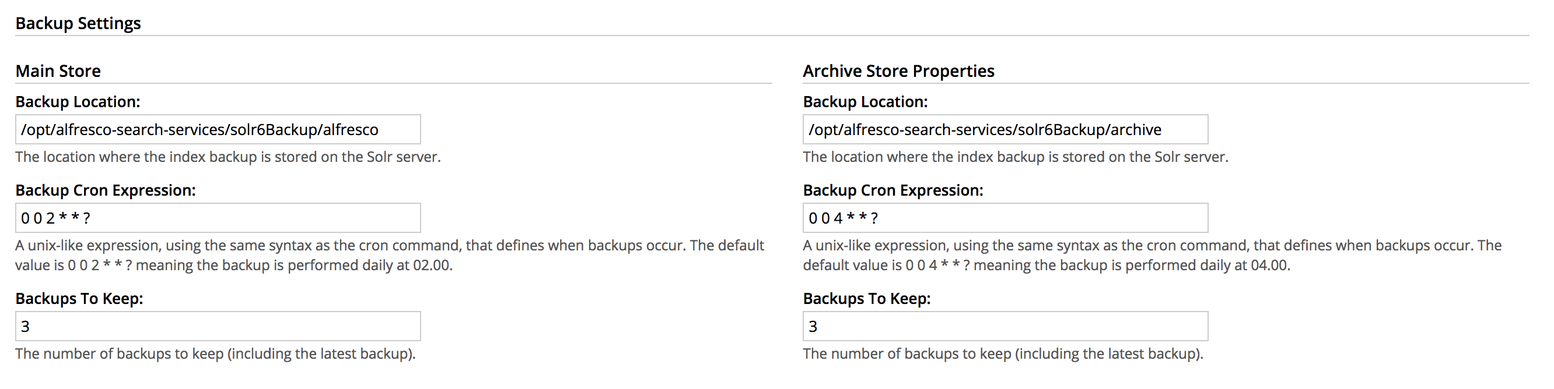
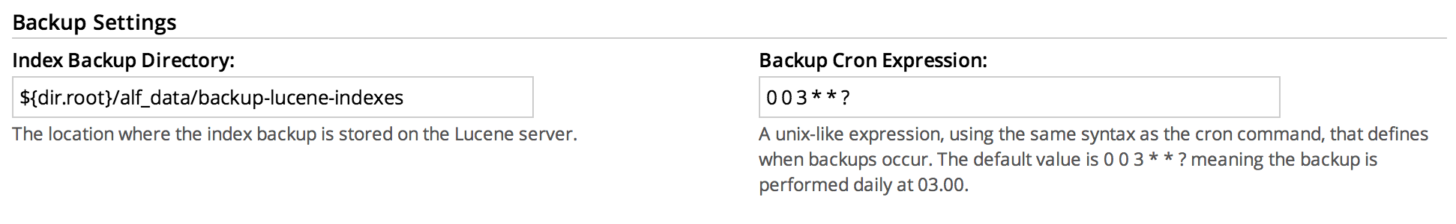
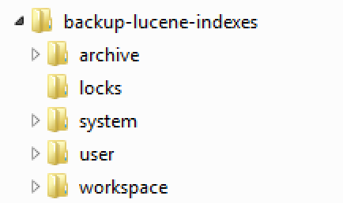
Alfresco Backup Overview
ACS Components:
Content Store ${dir.root}/contentstore (or S3)
Solr indexes and Solr caching content store
APS Components
contentstorage.fs.rootFolder (or S3)
ElasticSearch data elastic-search.data.path $user_home$/activiti-elastic-search-data
ACS Scheduled jobs:
system.content.orphanCleanup.cronExpression=0 0 4 * * ?
system.content.orphanProtectDays=14
system.content.eagerOrphanCleanup=false
solr.backup.alfresco.cronExpression=0 0 2 * * ?
solr.backup.archive.cronExpression=0 0 4 * * ?
Notes:
Static Data
Operating System (not covered by this procedure).
Application Server Install and configuration files.
Database installation files (if it is in same server, not recommendable).
Alfresco extensions (customizations).
3rd Party applications used by Alfresco (Open Office, ImageMagick, SWFTools).
Dynamic Data
Alfresco Indexes (Solr or Lucene)
Database (RDBMS data files, table spaces, archive logs and control files).
Alfresco Content Stores – the default and any other additional store used by Content Store Selector. Content Store Deleted is not required.
Indexes should be backed up first. If new rows are added in the database after the Lucene/SOLR backup is done, it’s still possible to regenerate the missing Lucene/SOLR indexes from the SQL transaction data.
Database backup should be performed next. If you have a SQL node pointing to a missing file, that node will be an orphan. If you have a file without a SQL node data, that file will not be included in the backup.
DB tools for backup: talk about

Slide 11

ACS Single tier: All-in-one
Alfresco Server
nginx HTTP 80 TCP
Alfresco Server
HA Proxy 9000 TCP
Alfresco Share (Tomcat) 8081 TCP
Alfresco Repo (Tomcat) 8070 TCP
Alfresco Index Solr (Jetty) 8090 TCP
Traffic through HA Proxy
Content Store
DB
Index storage
Browser Incoming traffic

Slide 12
ACS Two tiers: App + DB
Alfresco Server
DB Server
nginx HTTP 80 TCP
DB
HA Proxy 9000 TCP
Alfresco Share (Tomcat) 8081 TCP
Alfresco Repo (Tomcat) 8070 TCP
Alfresco Index Solr (Jetty) 8090 TCP
Content Store
Index storage

Slide 13
ACS Two tiers: App + DB + External Storage
Alfresco Server
DB Server
nginx HTTP 80 TCP
DB
HA Proxy 9000 TCP
Storage Server
Alfresco Share (Tomcat) 8081 TCP
Alfresco Repo (Tomcat) 8070 TCP
Alfresco Index Solr (Jetty) 8090 TCP
Content Store
Index storage

Slide 14
ACS Two tiers: Cluster App + DB + Shared Storage
DB Server
Alfresco Server 1
Alfresco Server 2
nginx HTTP 80 TCP
nginx HTTP 80 TCP
DB
HA Proxy 9000 TCP
HA Proxy 9000 TCP
Storage Server
Alfresco Share (Tomcat) 8081 TCP
Alfresco Repo (Tomcat) 8070 TCP
Alfresco Index Solr (Jetty) 8090 TCP
Alfresco Share (Tomcat) 8081 TCP
Alfresco Repo (Tomcat) 8070 TCP
Alfresco Index Solr (Jetty) 8090 TCP
Content Store
?
Index storage
Index storage

Slide 15
ACS Multi tier: Frontend + Cluster App + DB + Shared Storage + Others
DB Server
Frontend 1
Frontend 2
DB
nginx HTTP 80 TCP
nginx HTTP 80 TCP
Alfresco Server 1
Alfresco Server 2
Storage Server
HA Proxy 9000 TCP
HA Proxy 9000 TCP
Content Store
Alfresco Share (Tomcat) 8081 TCP
Alfresco Repo (Tomcat) 8070 TCP
Alfresco Index Solr (Jetty) 8090 TCP
Alfresco Share (Tomcat) 8081 TCP
Alfresco Repo (Tomcat) 8070 TCP
Alfresco Index Solr (Jetty) 8090 TCP
Index storage
Index storage
Transformation server or others

Slide 16
ACS Multi tier: Frontend + Cluster App + Index + DB + Shared Storage + Others
DB Server
Frontend 1
Frontend 2
DB
nginx HTTP 80 TCP
nginx HTTP 80 TCP
Alfresco Server 1
Alfresco Server 2
HA Proxy 9000 TCP
HA Proxy 9000 TCP
Storage Server
Content Store
Alfresco Share (Tomcat) 8081 TCP
Alfresco Repo (Tomcat) 8070 TCP
Alfresco Share (Tomcat) 8081 TCP
Alfresco Repo (Tomcat) 8070 TCP
Index Server 1
Index Server 2
Alfresco Repo (Tracking)
Alfresco Index Solr
Alfresco Repo (Tracking)
Alfresco Index Solr
Transformation server or others
Index storage
Index storage

Slide 17
All Alfresco Digital Business Platform Components
Alfresco CS Server 1
Alfresco PS Server 1
HA Proxy 9000 TCP
HA Proxy 9000 TCP
Content Store ACS
Alfresco Share (Tomcat) 8081 TCP
Alfresco Repo (Tomcat) 8070 TCP
APS (Tomcat) 8070 TCP
Index storage ElasticSearch
Content Store APS
Alfresco Search Services
Alfresco Repo (Tracking)
Alfresco Index Solr
Index storage Solr
ACS DB
ACS Desktop Sync DB
APS DB

Slide 18









ACS on AWS (Quick Start)
Elastic IPs (public route)
Internet gateway
Elastic IPs (public route)
NAT gateway
Bastion host
Bastion Auto Scaling group
NAT gateway
Public subnet
10.0.128.0/20
Public subnet
10.0.144.0/20
Elastic Load Balancing
Amazon S3 for shared content store
Alfresco Content Services Auto Scaling group
Alfresco servers
Alfresco servers
RDS DB instance
RDS DB instance standby
Private subnet
10.0.0.0/19
Alfresco Search Services Auto Scaling group
Private subnet
10.0.32.0/19
Index servers
Index servers
Virtual private cloud 10.0.0.0/16
Availability Zone 1
Availability Zone 2
AWS Region

Slide 19
What if we can deploy an ACS infrastructure 100% redundant, auto scalable, auto healing, across multiple physical locations with zero-downtime?
Real use case
Zero downtime would depend on major upgrades (database schema changes)

Slide 20
Requirements
Zero downtime
AWS Multi AZ replication
Auto-scaling out-in for Alfresco Repo tier
Auto-scaling out-up-down for Index tier
Self healing infrastructure (Chaos Monkey)
Solr sharding using DB_ID_RANGE:
Shard 1
Shard 2
Shard 3
Shard N
ID: 1-10M
ID: 10M-20M
ID: 20M-30M
ID: NM-NxM
Trigger
Auto-scaling out
Event
Trigger
Autos-scaling out
Event
Trigger
Auto-scaling out
Event

Slide 21
ACS and Solr Separated in Cluster Mode (Sharding Solr config DB_ID_RANGE) * THIS IS NOT AWS Quick Start
App ELB
AZ1
AZ2
NOTES:
Wide green arrows: Hazelcast repo cluster traffic
Search queries from repos are dynamic due to Dynamic Sharding (Not balancer required)
Green dotted arrows: Eventual search queries after scale out
Blue doted squares: Auto-scaling groups
Scaled Index servers: based on DB_ID_RANGE sharding method
DB Aurora MultiAZ, multi region capable
Content Store in a shared S3 bucket. S3 sync multi region capable.
EBS volumes backup logic underneath
Ephemeral Alfresco repo-share nodes
All instances placed here are in two private subnets in the same VPC
Alfresco Instance 1
Alfresco Instance 2
nginx HTTP 80 TCP
nginx HTTP 80 TCP
Hazelcast Share
Alfresco Share (Tomcat) 8081 TCP
HA Proxy 9000 TCP
Alfresco Repo (Tomcat) 8070 TCP
Alfresco Share (Tomcat) 8081 TCP
HA Proxy 9000 TCP
Alfresco Repo (Tomcat) 8070 TCP
Hazelcast Repo
cluster
cluster
Tracking 1
Network ELB
Tracking 2
Alfresco tracking repo (Tomcat) 8070 TCP
Pull tracking from all Solr instances
Alfresco tracking repo (Tomcat) 8070 TCP
Shard1
ID: 1-10M
Shard2
ID: 10M-20M
Shard3
ID: 30M-40M
Shard1R
ID: 1-10M
Shard2R
ID: 10M-20M
Shard3R
ID: 30M-40M
EBS Vol
Index data
EBS Vol
Index data
EBS Vol
Index data
EBS Vol
Index data
EBS Vol
Index data
EBS Vol
Index data
Multi AZ DB in RDS
S3 Content Store
Shard2 UP1
ID: 10M-20M
EBS Vol
Index data
Notes:
Ephemeral instances
S3 sync to other AWS region
RDS replicate to other AWS region
Jolokia logic: each index make backup of its storage and a pool of volumes are always tagged and ready to be used for auto-healing or scaling up purposes
All instances bases on AMIs, take 8 seconds to configure + OS start time and EC2 resource availability.

Slide 22
Solr6 and Sor4 backup trick: locations
Set a valid solr caching contentstore directory in your solr initd script.
-Dsolr.content.dir=/solr_data/contentstore
Set a valid solr data directory in solrcore.properties (template!!!)
data.dir.root=/solf_data/index

Slide 23
Solr6 and Sor4 backup trick: XFS storage
Disable Alfresco index side backup cronjob
Stop index tracking
curl -s -k --cert-type pem --cert ~/browser.crt.pem --key ~/browser.key.pem \ https://localhost:8983/solr/admin/cores?action=updateCore&property.enable.alfresco.tracking=false&coreName=alfresco
curl -s -k --cert-type pem --cert ~/browser.crt.pem --key ~/browser.key.pem \ https://localhost:8983/solr/admin/cores?action=updateCore&property.enable.alfresco.tracking=false&coreName=archive
Freeze XFS file system
xfs_freeze -f /solr_data/
Make volume snapshot
xfsdump / xfsrestore
Unfreeze XFS file system
xfs_freeze -u /solr_data/
Start index tracking
curl -s -k --cert-type pem --cert ~/browser.crt.pem --key ~/browser.key.pem \ https://localhost:8983/solr/admin/cores?action=updateCore&property.enable.alfresco.tracking=true&coreName=alfresco
curl -s -k --cert-type pem --cert ~/browser.crt.pem --key ~/browser.key.pem \ https://localhost:8983/solr/admin/cores?action=updateCore&property.enable.alfresco.tracking=true&coreName=archive

Slide 24
Tools
Alfresco BART https://github.com/toniblyx/alfresco-backup-and-recovery-tool
Thanks Douglas C. R. Paes for his contributions!
ContCentric sample script for Linux http://www.contcentric.com/alfresco-backup/
Jolokia for AWS: soon!

Slide 25
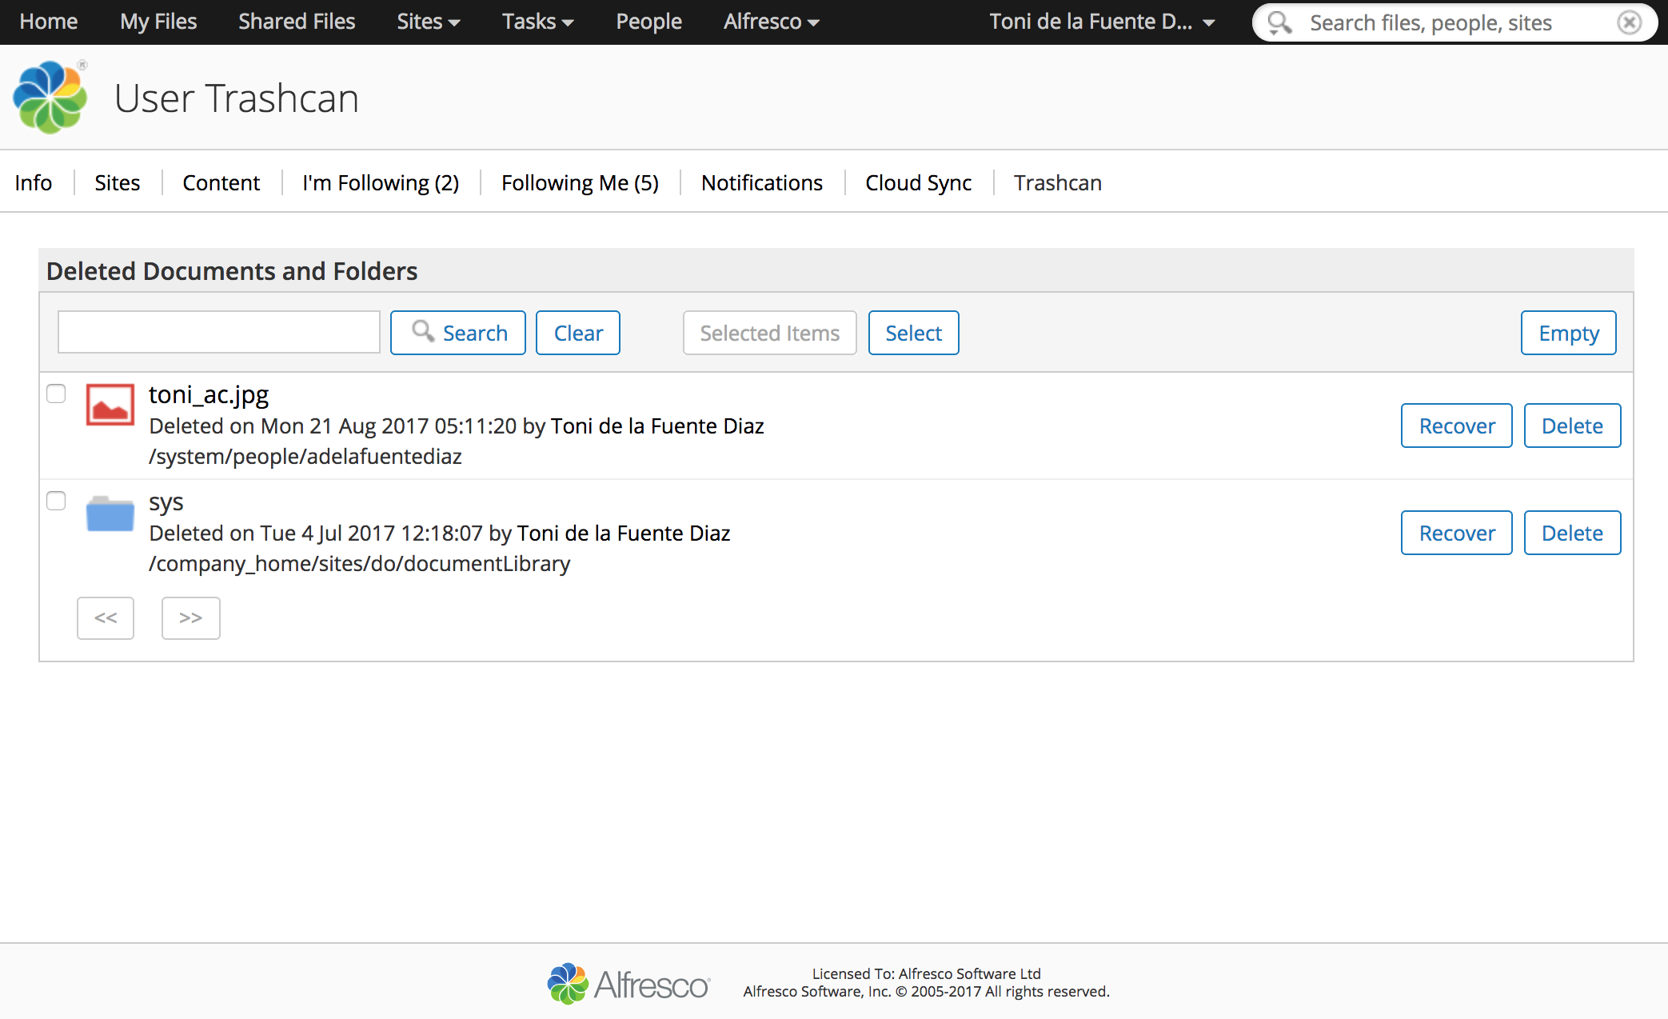
Restore Policy: End Users

Slide 26
Restore Policy: System Administrator
Installation
Configuration
Customization
DB
Content Store
Indexes

Slide 27
Road to success backing up Alfresco
Make all what you can redundant
Plan your storage strategy before hand
Break your stuff, all the time
Use ephemeral instances –> Move towards a CI/CD Pipeline
Monitor everything
Save logs of everything
Break your stuff again (Game Days!)

Slide 28
From Zero to Hero: Backing Up Alfresco
Thank you!
Special Thanks to:
Alfresco Search Services Team, Repo Team, JT Smith and Douglas C. R. Paes

Slide 29
Questions?

